Slide 1

Futurense Technologies
Project Report
Group 14 Names:
1. MD Talib
2. Abinav Harsha
3. Omkar Prasad
4. Keerthana Narkunaraja

Slide 2
Cracking passwords using Arduino [DigiSpark- keylogger]
Explore the potential of Arduino Digispark as a keylogger for cracking Linux passwords.
Cracking passwords on Linux systems can be achieved through various means, one of which involves utilizing a hardware keylogger device like the Arduino Digispark.
A keylogger is a device or software tool that records keystrokes entered on a computer keyboard covertly.
With the Arduino Digispark keylogger, an attacker can intercept keystrokes entered by a user on a Linux system, including passwords, without the user's knowledge.
Notes:
The Arduino Digispark is a tiny development board based on the ATtiny85 microcontroller. It's popular among hobbyists for its compact size and versatility. When programmed appropriately, the Digispark can act as a USB human interface device (HID), allowing it to mimic a keyboard and send keystrokes to a connected computer.

Slide 3
Project Statement
In the context of password cracking on Linux systems, an attacker may deploy the Arduino Digispark keylogger to capture login credentials entered by a user.
Once connected to the target system, the Digispark silently logs keystrokes and stores them for later retrieval by the attacker.
Using the captured keystrokes, the attacker can analyze the data to identify login credentials, including usernames and passwords.
These credentials can then be used to gain unauthorized access to the Linux system, potentially compromising sensitive data, resources, or even the entire network infrastructure.

Slide 4
Description
The project begins with a planning and setup phase on
Day 1, covering an overview of project requirements, task delegation, Linux environment setup, and installation of security tools.
Day 2 focuses on the implementation phase, involving risk assessments, shell scripting for vulnerability analysis, and the development of a keylogger
Day 3 encompasses testing and presentation, including thorough testing of security measures, finalizing the keylogger, and a presentation summarizing the project's objectives and outcomes.

Slide 5
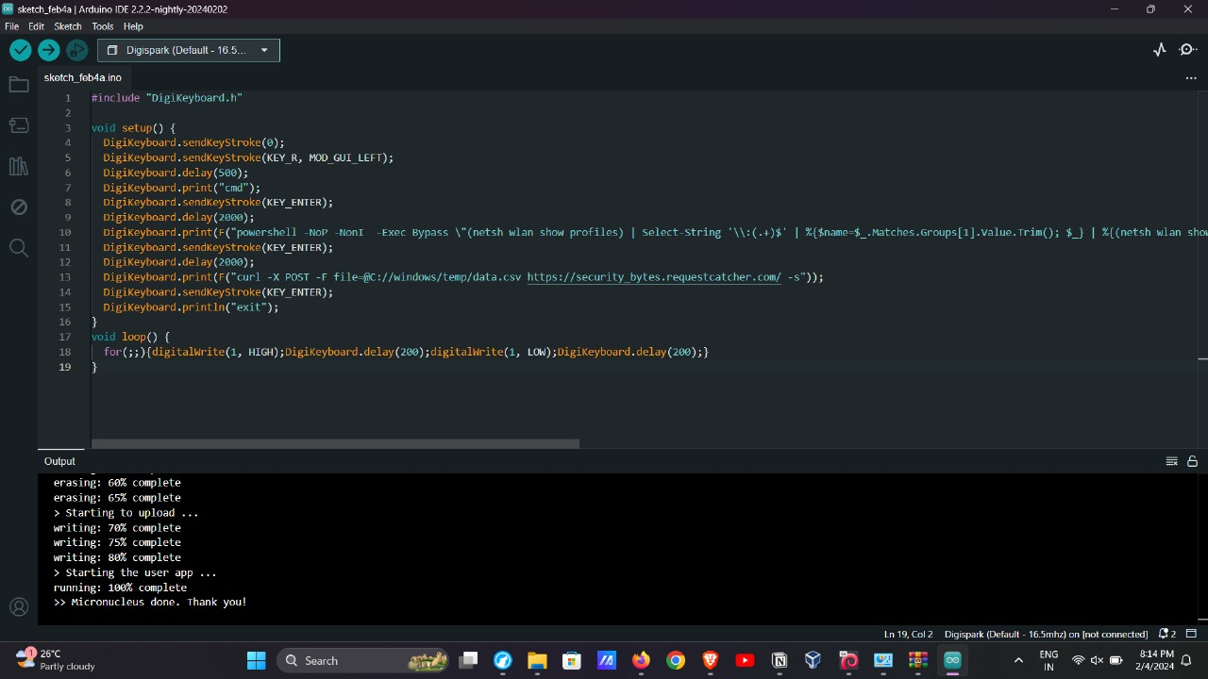
Code

Slide 6
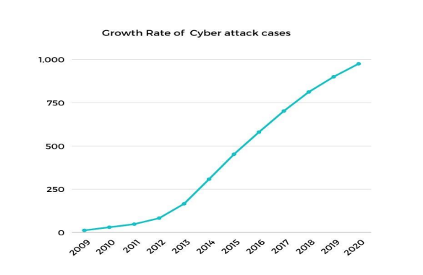
Figures/Graph

Slide 7
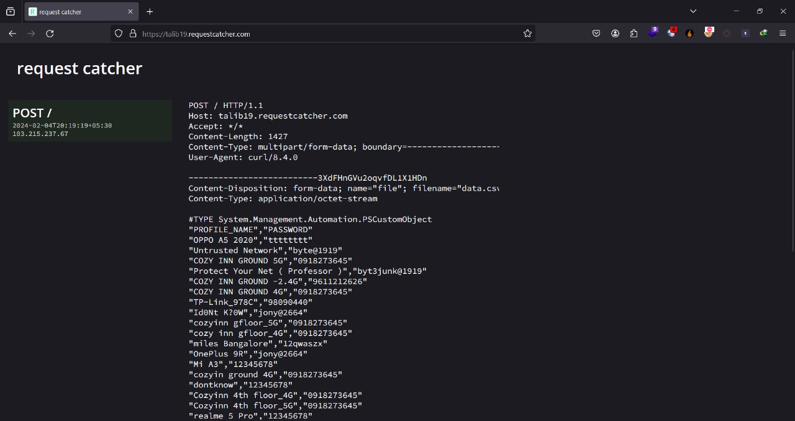
Results(Screenshot)

Slide 8
Conclusion
Furthermore, mitigating the risk of keylogger attacks involves implementing robust security measures such as regularly updating system software, using strong and unique passwords, employing two-factor authentication, and being vigilant for signs of unauthorized access or suspicious behavior on computer systems.
Using the captured keystrokes, the attacker can analyze the data to identify login credentials, including usernames and passwords.
These credentials can then be used to gain unauthorized access to the Linux system, potentially compromising sensitive data, resources, or even the entire network infrastructure.

Slide 9
References
[1] Kumar, S. S., & Venkatesan, S. (2021). Using USB Rubber Ducky to exploit target computers. Journal of Ambient Intelligence and Humanized Computing, 12(4), 3365-3374.
[2] Trivedi, S., & Joshi, R. (2019). Hacking with a $2 microcontroller: The Digispark Attiny85. International Journal of Advanced Research in Computer Science, 10(2), 413-418.
[3] Kumar, V. R., & Shidhaye, S. S. (2020). Using Digispark ATtiny85 as rubber ducky for exploiting windows operating system. International Journal of Engineering Research and Technology, 9(11), 193-197.
[4] Almutairi, A. (2018). The USB rubber ducky and Arduino microcontrollers: Tools for ethical hackers. International Journal of Cyber-Security and Digital Forensics, 7(3), 57-64.
[5] Das, A., & Saha, S. K. (2021). Digispark Attiny85 based USB Rubber Ducky Attack. International Journal of Computer Science and Information Security, 19(5), 36-41.

Slide 10
Thank you!!!

